Slide 1
MVC 5
(Model-View-Controller)
Klijentsko programiranje
Notes:
Prije početka pitati za iskustva koja polaznici imaju oko MVC 4.

Slide 2
Kreiranje client-side skripte
Pisanje inline client-side skripte na stranici:
Pisanje skripti kao odvojenih resursa:
<script language="javascript" type="text/javascript">
// Your script goes here
</script>
<head>
<title></title>
<script src="Site.js" type="text/javascript">
</script>
</head>
Notes:
Question: What benefits will you achieve by maintaining the client-side code in a separate script file?
Answer: Portability, easier debugging, modularity.
Question: What other operations can you perform to reduce the size of the client-side script?
Answer: Will vary.

Slide 3
Introduction to jQuery Library
jQuery is a JavaScript library that is supported in Visual Studio 2010
jQuery Selector syntax
  Works with DOM elements
jQuery events
  Easily trigger DOM events
$("#display").css("background-color", "yellow");
<input type="button" id="btn1" value="Greetings" />
<script type="text/JavaScript">
$(document).ready(function () {
$("#btn1").click(function () {alert(“hello world”);
});
});
</script>
Notes:
Most students will have very little experience with jQuery. Spend as much time as available ensuring that the students understand the basics. (They will be taught more throughout this class.)

Slide 4
Asinkrono dohvaćanje podataka
Služi za dohvaćanje podataka bez ponovnog učitavanja stranice
Tehnologija koja stoji iza ovakvog načina rada zove se – Ajax
SPA (Single Page Application) – cijela aplikacija je dostupna na samo jednoj stranici, bez ponovnih učitavanja, uz pomoć Ajax tehnologije
Dobivamo na brzini i boljem korisničkom iskustvu

Slide 5
Svrha Ajax-a
Ajax enables invocation of asynchronous calls, resulting in faster responses from the server.
Ajax request is triggered in the background, which does not require a complete page refresh.
Using Ajax, you can update a part of the page (also known as partial rendering).
Ajax helps bring the desktop experience to the browser.
Notes:
Stick to the bullet points and keep this topic short.

Slide 6
Pros and Cons of Using Ajax
Pros | Cons
Ajax request is triggered in the background, which does not involve the complete refresh of the page. | Ajax is JavaScript-dependent, which means that users who have JavaScript disabled will not be able to use Ajax.
Ajax effectively transfers small amounts of data to the server with seamless interaction. | Unpredictable browser behavior may result from using the Back button with an Ajax-enabled page.
Notes:
Present, and then discuss the pros and cons with the students.

Slide 7
Benefits of Using the Microsoft Ajax Library in MVC Pages
Performance — Enables developers to build high-performance, data-driven websites
Interoperability — Allows developers to use it with any server platform, and alongside jQuery
Extensibility — Enables developers to build on top of the library with ease
Notes:
Module 13: Implementing Ajax in a Web Application
Course 10264A
It is important to point out that the library “plays well” with jQuery, because we will be using jQuery later in this module.

Slide 8
How to Use the Microsoft Ajax Library in MVC Pages
Referencing the Microsoft Ajax Libraries
Using the MVC Ajax helper library function Ajax.ActionLink
Using the MVC Ajax helper library function Ajax.BeginForm
Notes:
Module 13: Implementing Ajax in a Web Application
Course 10264A
Point out that users can reference the scripts via the script loader, or through the Microsoft content delivery network.
MVC has many HTML helper methods that are used to simplify the process of building views. One of the most common helpers is the ActionLink, which uses routing to build an anchor tag (<a href="/some/path"> Some Link </a>), which will link to a controller method.
The Ajax.ActionLink, which is similar, is often used to fetch a new view of data, and enables you to call a controller action asynchronously.
Similarly, a BeginForm helper method is commonly used to build out a form. The Ajax.BeginForm is used to “POST” data asynchronously to the server.

Slide 9
Implementing Ajax in Asp.Net MVC Pages Using jQuery
  jQuery.load method
  jQuery.get method
  jQuery.post method
  jQuery.ajax method
Notes:
Module 13: Implementing Ajax in a Web Application
Course 10264A
jQuery has a handful of functions that make the easy parts really easy, and the complex parts as simple as possible.
Just as jQuery makes finding elements on a web page easy with its awesome selector syntax, it also has a very powerful (and small) Ajax Library.
You can use high-level methods to perform simple operations (load, get, post), but you can also use a low-level method to customize the way you want to communicate with the server (jQuery.ajax()).
$.load — Used with a selector to load data into the selected object, that is, (‘div:first’).load(“/customer/1”) would load the result from the GET customer controller action into the <div></div> on the page.
$.get — Issues a get request to the specified URL. Unlike the load function, the get does not automatically put the results on the page. get is typically used with a callback method that processes the response from the server.
$.post — Posts data to the server. Typically used to post small forms, or small chunks of data.
$.ajax — Used to fine-tune the communication with the server. Typically used when you need to do things that are outside of the default behavior. A good example is if you want to handle the exception for a specific call differently than the rest of your Ajax calls. You might want to use one of the less common HTTP actions (put, delete, and so on), or send a request instead.
Point the users to http://jquery.com and the Ajax documentation, which is the best resource for learning which methods are available. Also, it typically has good samples.

Slide 10
jQuery.load Method
Syntax:
Calls the server and loads the HTML into an area of the page.
element.load(url, [data],
[callback(response, status, XMLHttpRequest)]
$('#returnValue').load(
'localhost/loadtest.htm #container');
Notes:
Module 13: Implementing Ajax in a Web Application
Course 10264A
Be sure to explain that “#result” is the selector for the element whose inner HTML will be replaced with the results from the inner HTML of the #container element on the ajax/test.html page.
Any function given to the load method as the success callback will be invoked after the results have been loaded into the element on the page.
Note: The document retrieved cannot be a full HTML document; that is, it cannot include (for example) <html>, <title>, or <head> elements. jQuery uses the browser’s innerHTML property on a <div> element to parse the document, and most browsers will not allow non-body elements to be parsed in this way. In MVC, this means that the view rendered must be a partial view for the behavior of the load method to be consistent across browsers.

Slide 11
jQuery.get Method
The jQuery.get method makes a GET request to the server.
jQuery.get takes a URL, the object representing the data to pass with the request, and the success callback
$.get("localhost/employeedetails.html",
{ employeeId: 123, name: "Jeffrey" },
function(data){
alert("Employee details retrieved: " + data);
});
Notes:
Module 13: Implementing Ajax in a Web Application
Course 10264A
Although all of the parameters for this method are optional, typically, all three are used. Be sure to cover the caching issues with GET requests. If caching behavior is desired, this is the perfect match. However, when caching behavior is not wanted, this can be a source of hard-to-find bugs.
Caching can be overcome by passing a new Date() object as one of the data parameters when calling, but this is considered a hack.
To turn off caching behavior, look at the cache parameter of the ajaxSetup method. There are several parameters in this method that help you fine tune your caching behavior.

Slide 12
jQuery.post Method
The POST verb is typically used to indicate that the request is changing data on the server
POST requests are never cached, unlike GET requests
$.post("localhost/employeedetails.html",
{ some: 'data', for: 'the request'},
function(data) {
alert("Employee details retrieved: " + data);
});
Notes:
Module 13: Implementing Ajax in a Web Application
Course 10264A
This may be a good time to go over the POST and GET HTTP verbs in more detail.
GET requests indicate that the data being retrieved will not be changed. In other words, when a GET request is made, the results of that request may (and will) be cached by the browser or any other servers along the way.
POST requests indicate to the server that the data being requested may be changed, and therefore, POST requests are never cached.
To improve performance, the jQuery.get method should be used whenever possible.
The ajaxSetup caching parameter has no effect when the post method is used because POST requests are never cached.

Slide 13
jQuery.ajax Method
Low level method used by all other Ajax methods in jQuery.
Takes a hash of parameters.
url, type, data, and success are the most commonly used parameters.
The error parameter can also be used to create a custom error handler.
Notes:
Module 13: Implementing Ajax in a Web Application
Course 10264A
Taking a hash for the parameters in jQuery is a common pattern. If the class is not already familiar with this style for passing an argument, be sure to explain it.
A hash would look something like this:
{url: “some/url”, data: “employeeid:1”, success: SomeFunction}
Putting it all together:
$.ajax({url: “some/url”, data: “employeeid:1”, success: SomeFunction});

Slide 14
Working with jQuery and Ajax Events
jQuery.ajaxSend Event Handler
jQuery.ajaxComplete Event Handler
jQuery.ajaxError Event Handler
Notes:
Module 13: Implementing Ajax in a Web Application
Course 10264A
jQuery also provides some helper functions that help you plug into the Ajax event pipeline.

Slide 15
Sintaksa jQuery Ajaxa
$.ajax({
url: '...',
type: '...',
data: { var1: test,1 var2: test2, ...},
beforeSend: function () {
//kod
},
success: function (result) {
//kod
},
error: function ( jqXHR, textStatus, errorThrown) {
//kod
},
complete: function () {
//kod
}
});

Slide 16
Primjer ajax poziva
$.ajax({
url: '/Predavaci/Lista',
type: 'GET',
traditional: true,
data: { arr: test, someBool: true, someInt: 1, someString: '', id: $(this).attr('id') },
beforeSend: function () {
alert("Prije slanja!");
},
success: function (result) {
$("#listaPredavaca").html('');
result.forEach(function (entry) {
$("#listaPredavaca").append("<p>" + entry.Ime + " " + entry.Prezime + "</p>");
});
},
error: function ( jqXHR, textStatus, errorThrown) {
alert(jqXHR.responseText);
},
complete: function () {
alert(„Gotovo!");
}
});

Slide 17
Dodatak!
Postoje razne JavaScript biblioteke, koje se pojavljuju na tržištu vrlo velikom brzinom
Neke od biblioteka su specializirane, dok druge nastoje osigurati kompaktnu razvojnu okolinu za razvoj cijelih web aplikacija
Koje od njih koristiti je ponekad teško pitanje ...

Slide 18
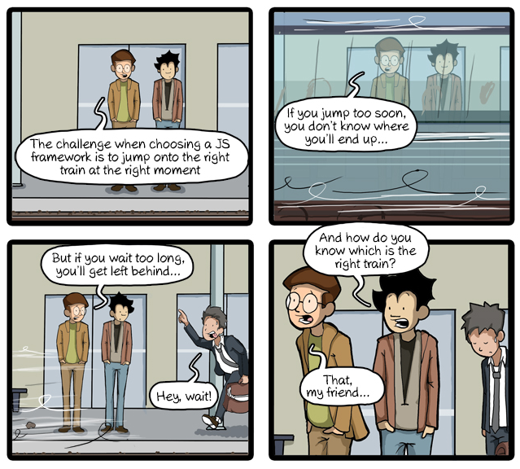

Slide 19
